Slide 1
Demonstration Speech
Finding a Good Topic and Planning for Success

Slide 2
Work from Your Strengths
Demonstrate something that you know very well and like doing.
  From your career area.
  From your hobbies or interests.
Make sure it is practical.
  Does the demo fit in the allowable time?
  Can you set up and break down quickly?
  How much equipment and material can you handle? Will you need an assistant?

Slide 3
Will They Be Interested?
Remember your audience analysis.
What questions will the audience have?
Can you hold their attention while processes take place?
Strategies for involvement.

Slide 4
Build Your House
The foundation is the topic: “ I want to demonstrate how to run a code.”
The walls come next with a central idea: “It is good to know how to run a code because it is important for most of computer science graduates.”
The front door is why it is important to the audience.”
The roof is the demo. Show them!
Beware the wrecking ball. What can go wrong?

Slide 5
Items of Concern
What can go wrong and how can I prevent it?
Will it make a mess?
This is way too complicated! Can you break it down?
Does it need special conditions?

Slide 6
Demonstration Speeches
Above all else – demonstration speeches are SPEECHES!
They have:
  An introduction
  A body
  A conclusion
  They have transitions
  And, they have supporting evidence.
They should NOT have dead air time!

Slide 7
Demonstration Speeches
Teaches. . .
Provides answers to the question “How do you do that?”
Also known as “how to” speech.
Type of informative speech.

Slide 8
Attention Getter and
Memorable Close
Even though you are showing the audience how to do something, you still need an enticing attention getter (an introduction) and a memorable close (conclusion).

Slide 9
Preparing a Demonstration Speech
Think first. . .
What are the required steps or stages
What comes first?
What’s absolutely essential?
Which step is easiest?
Which step is hardest?
What does the audience already know how to do?
Where will the audience be most likely to get confused?
Which step takes the most time?
Which take very little time?

Slide 10
Organizing a Demonstration Speech
Then plan. . .
Organize steps in order.
Clarify and simplify difficult steps.
Think about the physical space of the room.

Slide 11
Audience Participation
Be in control. . .
Only use audience participation that is practiced ahead of time or is highly controlled.

Slide 12
Don’t Assume You Know
Think again. . .
Just because you are demonstrating something you know how to do…doesn’t mean you can automatically explain it to an audience.

Slide 13
Visual Aids
Plan again. . .
What actual objects will you need.
What gaps will you need to fill in.
Practice working with your props.

Slide 14
Abstract versus Concrete
Avoid potholes. . .
Abstract Topics: Challenge is to make it visual.
Concrete Topics: Challenge is to make it new and different.

Slide 15
Condensing Time
Create stages. . .
Prepare several different versions of the items at different points in the process.

Slide 16
Answer THE Two Audience Questions
Why should I care?
Why should I believe you?

Slide 17
Practice Canon is Key
Rehearsal is one of the keys to delivering an effective demonstration speech.

Slide 18
Demonstration Speeches
Make sure you choose a topic that is narrow or big enough
that you can actually demonstrate it in 5-8 minutes.
Can your topic be broken down into steps? If not, think again!
Prepare ahead of time non-essential steps.
No dead air time!
Modify the demonstration.
Have a completed sample.

Slide 19
Demonstration Speeches – con’t.
Include your audience.
Don’t use jargon or technical terms. Or, explain! ! !
No last minute volunteers – plan ahead!
Make sure it is a speech –
  Introduction
  Body
  Conclusion
  Transitions
  Supporting Evidence
Practice, practice, practice!

Slide 20

Before the presentation…
Preparation is key!
  Figure out a thesis for your paper.
  Write down the structure for your presentation.
    Introduction, body, and conclusion.
  Read it out loud.
  Edit your writing.
  Read it out loud again.
  Put it into your presentation.
  Practice again.

Slide 21
Tips
Attitude is everything!
Preparation is key
Confidence comes with practice
Refer to sources correctly
  You will need to have outside sources for your information in the presentation. Make sure to know how to pronounce names and the author’s main idea correctly.
First 30 seconds are the most important!
  This is the hook.
  If you have a creative, witty, or interesting introduction, you can hold the audience’s attention for the rest of the presentation.
Strong conclusion
  Just like the introduction, have a strong message the audience can take away from your presentation.
  Avoid just repeating your introduction and your thesis statement.
  Action statements make good conclusions.

Slide 22
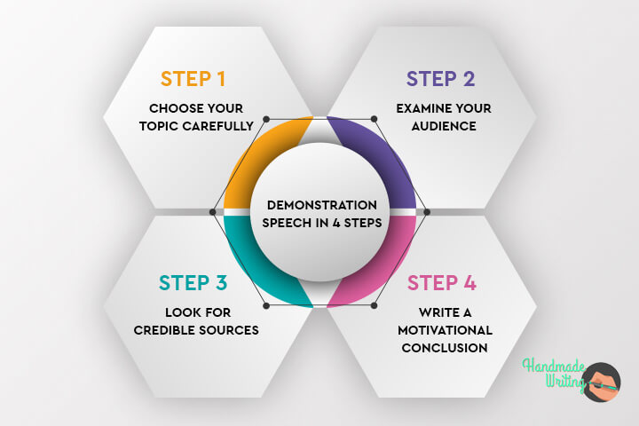

Slide 23
Task Allocation Time
Till the Weekend Get your topics and group (4-6 members) ready.
Share your topic & group details by 2nd May 2024 till midnight.
Lab 15:
Listening Final Exam
LAB 16:
Marked Task: Demonstrative Speeches

